Slide 1
Business Rules Engine

Slide 2
Agenda
What is Rule?
What is Rule Engine?
Why use Rule Engine?
When not use Rule Engine?
How it work?

Slide 3
What is Rule?
Insurance rule
The car is red
And the car is a sport class
And the driver is male
And the driver is between the ages of 16-25 then 20% insurance increase.
rule "Invoice should be possible for all categories except project type Basic Costs and Cost Center allow Invoice transaction"
when
Project( Category != "Basic Costs", CostCenter.canInvoice )
then
addTransactionType("Invoice");
end
A rule is composed of two parts, a condition and an action: When the condition is met, the action is executed.

Slide 4
What is Rule Engine?
A rule engine is a mechanism for executing rules Instead of embedding in normal program code => use rule form.
Some Java rules engines
Drools
OpenL Tablets
Easy Rules
RuleBook
...

Slide 5
Why use Rule Engine?
Symplified complicated requirements with declarative logic (how?)
Different approach to solving problems, some problems are much easier using rules
Particular pattern:
Externalize business logic (which are too dynamic) from the static code
Support rapid change (without redeploy)
Handle complicated rules
Scalable

Slide 6
When not use Rule Engine?
They are called "Business Rules" for a reason, do not use rules when you cannot design a system that can be easily maintained/understood by Business users.
Do not use rules as an alternative to code deploy. ​
Business logic is well-defined or static and doesn't change often
It’s just another tools in your tool box

Slide 7
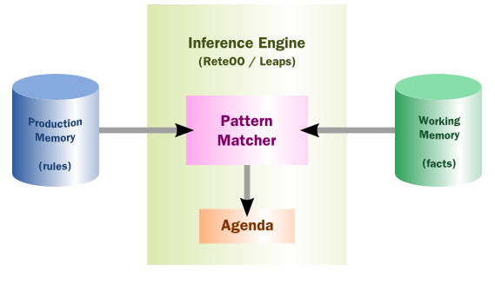
How it works?
Pattern matcher: Determine which rules to apply to the data in working memory.
Agenda: Determine the order of conflicting rules (rules being true for the same fact) based on conflict resolving strategy

Slide 8
How it works?
Rule execution methods
Forward chaining
Backward chaining

Slide 9
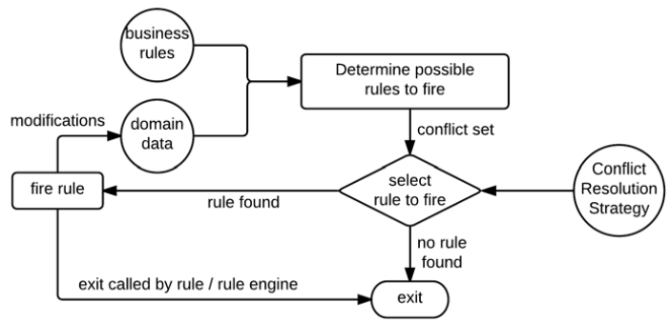
How it works?
Forward chaining (data driven)
Rules + Facts -> Rule Engine
-> Conclusion/Action
Example: I have a new pet, Fritz
Facts
Fritz croaks
Fritz eats flies
Rules
If X croaks and X eats flies – Then X is a frog
If X chirps and X sings – Then X is a canary
If X is a frog – Then X is green
If X is a canary – Then X is yellow
Goal: Color of Fritz?
Notes:
modimodiidfmodification facts?

Slide 10
How it works?
Backward chaining (goal driven): Starts with a list of goals and works backwards from the consequent to the condition to see if there is data available that will support any of these consequents.
An inference engine using backward chaining would search the rules until it finds one which has a consequent (then clause) that matches a desired goal. If the condition (if clause) of that rule is not known to be true, then it is added to the list of goals.
Rules + Facts + Goal -> Rule Engine -> Goal is satisfied?

Slide 11
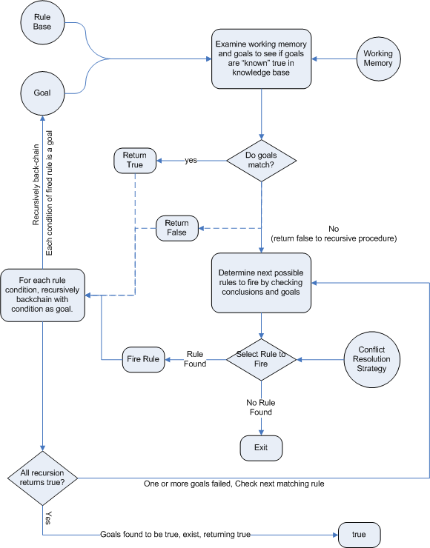
How it works?
Example:
Facts
Fritz croaks
Fritz eats flies
Rules
If X croaks and X eats flies – Then X is a frog
If X chirps and X sings – Then X is a canary
If X is a frog – Then X is green
If X is a canary – Then X is yellow
Goal: Whether Fritz is green?

Slide 12
How it works?
When use rule engine with backward chaining, when use rule engine with forward chaining?

Slide 13
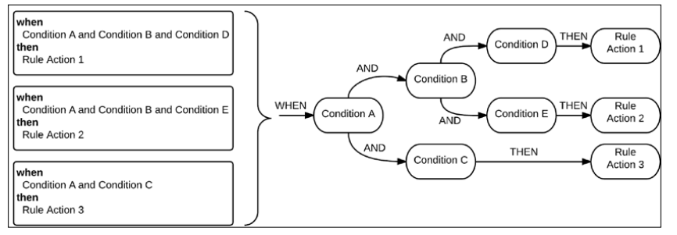
How it works?
Pattern matching algorithms:
Linear
Rete
Treat
Leaps
...
Drools 6 uses PHREAK (improve from RETE): Transform rules to execution tree
Notes:
Select rules to fire

Slide 14
How to write application using rule engine?
Write rule (file, database…)
Bootstrap the Rule Engine
Load rules
Provide facts
Execute
Notes:
Page 24

Slide 15
How to write rule?
Vary from rule engines
Native Rule Language
DSL (Domain Specific Language)
XML
DMN (Decision Model and Notation)
Decision table
….

Slide 16
Thank you!

